Slide 1


Approaches to Brain Health Conversation and Assessment for Older Adults and Their Care Partners
Janine Overcash, PhD, ARNP-CNP, FAANP, FAAN
A training offered through the Golden Buckeye Center for Dementia Caregiving
Developed by:
Morgan Fitzgerald, MPH, CHES
Mary Beth Happ, PhD, RN, FGSA, FAAN
Allison Macerollo, MD
Janine Overcash, PhD, APRN-CNP, FAANP, FAAN
Karen Rose, PhD, RN, FGSA, FAAN

Slide 2
Learning Objectives
Demonstrate an increase in awareness of cognitive decline, Alzheimer’s Disease and other related dementias;
Explain why cognitive testing is important and when cognitive testing should be performed;
Know how to effectively communicate and discuss brain health with older adults and their care partners;
Select the tools to assess and evaluate cognitive impairment in a timely way; and,
Explain how to refer the patient and their care partners to community services and other resources.

Slide 3










Golden Buckeye Center for Dementia Caregiving | Contributing Organizations
Area Agencies on Aging & Local Offices on Aging

Slide 4

Golden Buckeye Center for Dementia Caregiving
Purpose
A unique care partner-focused center offering virtual and in-person training about dementia and dementia caregiving
Resources for Clinicians/Health Professionals
Training curriculum & materials
Dementia screening & assessment toolkit
Directory of dementia caregiving resources, referral protocol and referral toolkit
https://nursing.osu.edu/dementiacaregiving

Slide 5
Cognitive Assessment in Primary Care

Slide 6
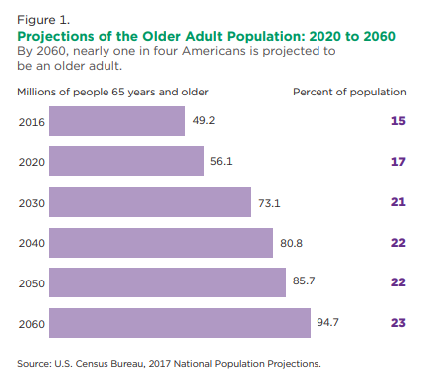
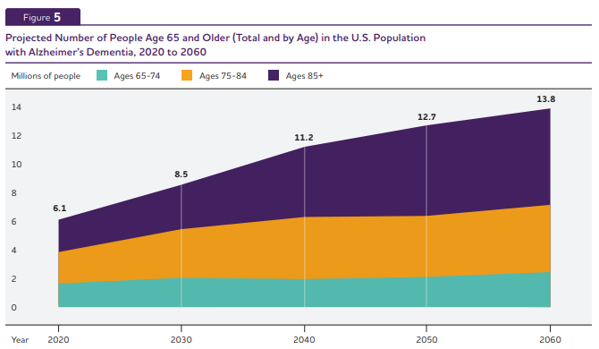
Older Adult Population in the U.S.
Alzheimer’s disease is one of the common diseases among older adults.
Vespa, J., Medina, L., & Armstrong, D. M. (2018). Demographic Turning Points for the United States: Population Projections for 2020 to 2060 (pp. 25–1144). US Department of Commerce, Economics and Statistics Administration, US Census Bureau.
Alzheimer’s Association. (2023). 2023 Alzheimer’s disease facts and figures. Alzheimer’s & Dementia, 19(4), 1598–1695. https://doi.org/10.1002/alz.13016

Slide 7
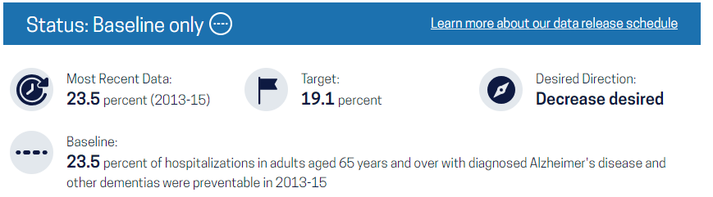
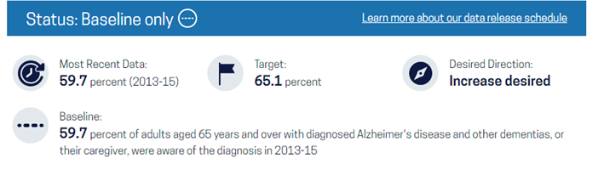
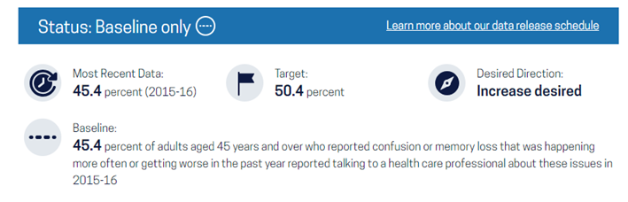
Dementia Objectives in Healthy People 2030 https://www.cdc.gov/alzheimers-dementia/healthy-people-2030/index.html
Goal:
Improve Health & Well-Being for Older Adults
Core Objectives:
Increase the proportion of older adults with dementia, or their caregivers, who know they have it – DIA-01
Reduce the proportion of preventable hospitalizations in older adults with dementia – DIA-02
Increase the proportion of adults with subjective cognitive decline who have discussed their symptoms with a provider – DIA-03

Slide 8

Screening and Evaluation of Dementia
Lies with Primary Care Providers
591,000 Ohio adults experienced cognitive decline, but more than half (51%) have never discussed their confusion or memory loss with a healthcare professional (Ohio Department of Health, 2020)
PCPs are most likely to make the initial diagnosis of dementia (Liss et al., 2021)
85% of patients with dementia (Medicare beneficiaries) were diagnosed by providers who do not specialize in dementia (Drabo et al., 2019)
  Most do not receive specialty care, even 5 years after diagnosis
PCPs often have long-standing relationships with patients and can recognize clinical manifestations of cognitive decline
Many never receive a dx of AD or MCI (Liss et al. 2021)
Chronic Disease Stats & Facts for Ohio: Cognitive Decline & Dementia. Oct 2020. https://odh.ohio.gov/wps/wcm/connect/gov/44a0bd5b-045a-488c-9730-e72fd38207fd/Cognitive+Decline+and++Dementia+in+Ohio+Fact+Sheet_Final.pdf?MOD=AJPERES&CONVERT_TO=url&CACHEID=ROOTWORKSPACE.Z18_K9I401S01H7F40QBNJU3SO1F56-44a0bd5b-045a-488c-9730-e72fd38207fd-npD1eEi
Drabo EF, Barthold D, Joyce G, Ferido P, Chang Chui H, Zissimopoulos J. Longitudinal analysis of dementia diagnosis and specialty care among racially diverse Medicare beneficiaries. Alzheimers Dement. 2019 Nov;15(11):1402-1411. doi: 10.1016/j.jalz.2019.07.005. Epub 2019 Sep 4. PMID: 31494079; PMCID: PMC6874742.
Liss JL, Seleri Assunção S, Cummings J, et al. Practical recommendations for timely, accurate diagnosis of symptomatic Alzheimer’s disease (MCI and dementia) in primary care: a review and synthesis. J Intern Med. 2021;290(2):310-334. 706.
2024 Alzheimer's disease facts and figures. Alzheimers Dement. 2024 May;20(5):3708-3821. doi: 10.1002/alz.13809. Epub 2024 Apr 30. PMID: 38689398; PMCID: PMC11095490.

Slide 9
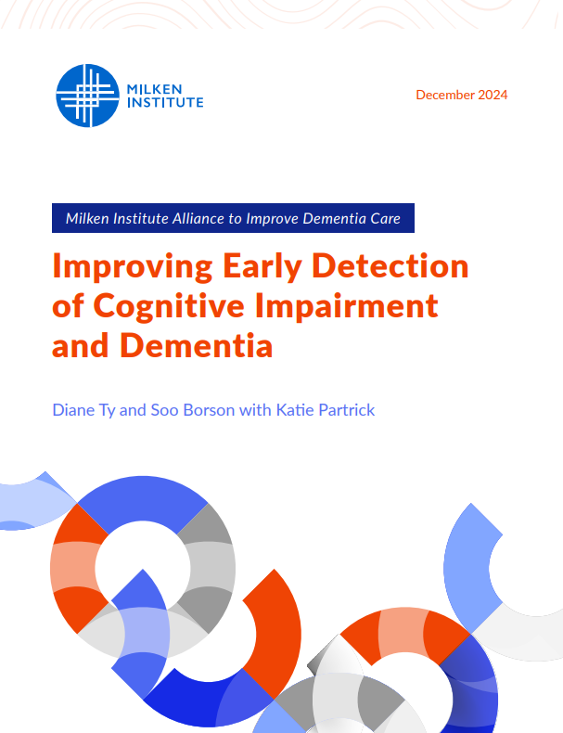
Improving Early Detection – Milken Institute
Theme 1: Enhancing Primary Care Capacity and Cognitive Assessment Workflows
Normalize brain health discussions, expand education, and tailor training for primary care providers
Integrate cognitive assessment tools into clinical workflows at the health system level
Establish appropriate reimbursement policies to encourage cognitive assessments
Theme 2: Expanding Detection beyond Primary Care
Expand training and support to specialty physicians and allied health professionals
Expand and support early detection in community settings
https://milkeninstitute.org/content-hub/research-and-reports/reports/dementia-mci-improving-early-detection

Slide 10
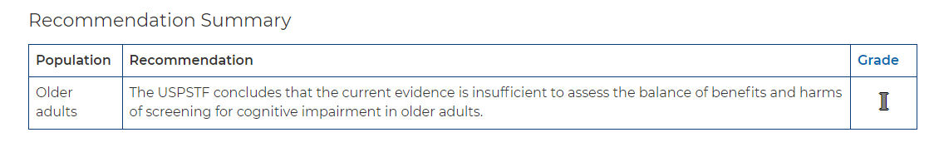
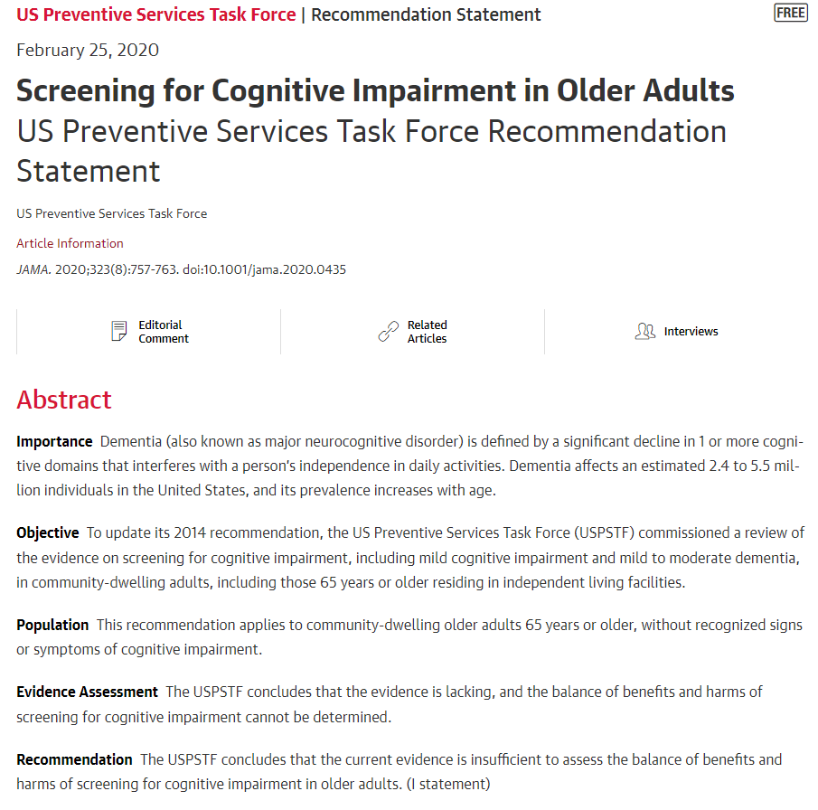
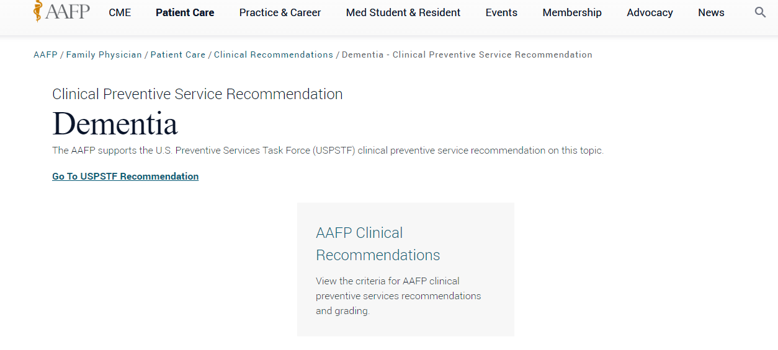
USPSTF
The evidence for this recommendation was from a population of community-dwelling seniors without signs of cognitive impairment.
Testing people who are unlikely to have cognitive impairment can lead to false positives, which may cause unnecessary stress and worry among older adults and their families.

Slide 11
Why Screen for Early Dementia?

Slide 12
Dementia Care Management
October 2017
Effectiveness and Safety of Dementia Care Management in Primary Care
A Randomized Clinical Trial
Jochen René Thyrian, PhD¹; Johannes Hertel, Dipl-Psych^{1,2}; Diana Wucherer, Dipl-Pharm¹; et alTilly Eichler, PhD¹; Bernhard Michalowsky, PhD¹; Adina Dreier-Wolfgramm, PhD³; Ina Zwingmann, PhD¹; Ingo Kilimann, MD⁴; Stefan Teipel, MD^{4,5}; Wolfgang Hoffmann, MD, MPH^{1,3}
Author Affiliations Article Information
JAMA Psychiatry. 2017;74(10):996-1004. doi:10.1001/jamapsychiatry.2017.2124
Findings: RCT of 634 people with dementia, care management decreased behavioral and psychological symptoms and caregiver burden.

Slide 13
Medicare Annual Wellness Visits
October 8, 2024
Annual Wellness Visits and Early Dementia Diagnosis Among Medicare Beneficiaries
Huey-Ming Tzeng, PhD^{1,2}; Mukaila A. Raji, MD, MS^{2,3}; Yong Shan, PhD^{4,5}; et alPeter Cram, MD, MBA^{6,7}; Yong-Fang Kuo, PhD^{2,3,4,5}
Author Affiliations Article Information
JAMA Netw Open. 2024;7(10):e2437247. doi:10.1001/jamanetworkopen.2024.37247
Findings: In this cohort study of 549 516 Medicare beneficiaries, AWV was associated with a 21% increase in MCI diagnosis and a 4% increase in ADRD diagnosis.

Slide 14

Alzheimer’s Association Resources for Medical Professionals
Benefits of Early Detection
Early treatment
More time for future planning
Potential for clinical studies
Participation in decision making
Access to support services
Who should be evaluated for cognitive impairment?
Videos demonstrating cognitive assessment
Medicare Annual Wellness Visit
Indications for referral
Recommended cognitive assessment tools
Help and support for your patients
https://www.alz.org/professionals/health-systems-medical-professionals/cognitive-assessment

Slide 15
Detection of Cognitive Problems can lead to Pharmacological and Non-Pharmacological Treatment of Dementia, Mild Cognitive Impairment, and Alzheimer's Disease

Slide 16

Non-Pharmacological Treatment
Extensive lifestyle changes improve cognition and slow the progression of MCI (Ornish et al., 2024)
Ornish D, Madison C, Kivipelto M, Kemp C, McCulloch CE, Galasko D, Artz J, Rentz D, Lin J, Norman K, Ornish A, Tranter S, DeLamarter N, Wingers N, Richling C, Kaddurah-Daouk R, Knight R, McDonald D, Patel L, Verdin E, E Tanzi R, Arnold SE. Effects of intensive lifestyle changes on the progression of mild cognitive impairment or early dementia due to Alzheimer's disease: a randomized, controlled clinical trial. Alzheimers Res Ther. 2024 Jun 7;16(1):122. doi: 10.1186/s13195-024-01482-z. PMID: 38849944; PMCID: PMC11157928.

Slide 17
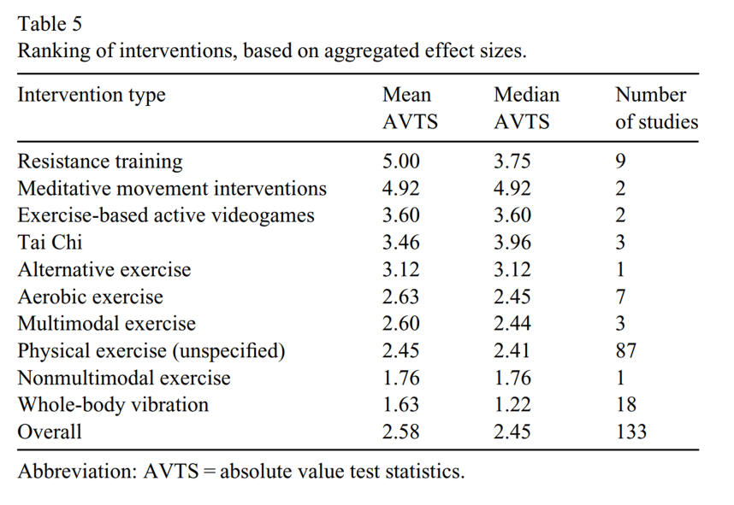
Exercise interventions for older adults: A systematic review of meta-analyses (Di Lorito et al., 2020)
J Sport Health Sci 2020 Jun 7; 10(1):29-47. doi: 10.1016/j.jshs.2020.06.003
This study aimed to review physical exercise characteristics to identify which may be the most effective
35 meta-analyses were included
Most interventions were delivered in homes vs. community settings
Improvements in muscle strength were found
No improvement in QOL
Seated exercise had a significantly positive effect on cognition

Slide 18
Pharmacological Treatment

Slide 19
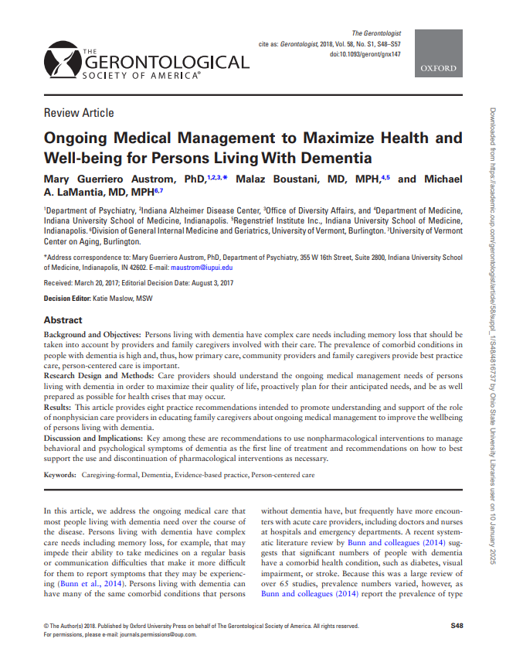
Pharmacological Treatments
Cholinesterase Inhibitors
Memantine (Namenda)
Immunotherapy Drugs
Ongoing Medical Management to Maximize Health and Well-being for Persons Living With Dementia - PubMed
Austrom MG, Boustani M, LaMantia MA. Ongoing Medical Management to Maximize Health and Well-being for Persons Living With Dementia. Gerontologist. 2018 Jan 18;58(suppl_1):S48-S57. doi: 10.1093/geront/gnx147. PMID: 29361066; PMCID: PMC5881733.

Slide 20

Research → Practice
NIH Professional Judgment Budget for Alzheimer's Disease and Related Dementias for Fiscal Year 2023: Transforming Research To Prevent, Detect, Treat, and Provide Better Care for Dementia
Snapshot of scientific advances and new programs initiated with NIH investments in Alzheimer’s and related dementia research
Summarizes achievements in the following areas:
  Biomarker Research
  Research on Tools to Detect Cognitive Changes
  Clinical Study Recruitment Initiatives to Enhance Diversity
  Drug Candidates
  Lifestyle, Behavior, and Cognitive Training Intervention Research
  Care and Caregiver Support Studies
  Population Studies and Health Disparities
  Disease Mechanisms

Slide 21
WHO should receive cognitive screening and WHEN?

Slide 22
Risk Factors for Dementia
Risk factors for dementia | Alzheimer's Society
Non-Modifiable Risk Factors​
  > 75 years old​
  Genes (inherited risk)​
  Women are generally at a higher risk
Modifiable Risk Factors
  Cardiovascular Health: Hypertension, diabetes, and high cholesterol can increase the risk.
  Lifestyle Choices: Smoking, excessive alcohol consumption, and a sedentary lifestyle.
  Diet: Poor diet, particularly one high in saturated fats and sugars.
  Mental and Social Engagement: Low levels of mental stimulation and social interaction.
  Education: Lower levels of formal education

Slide 23

Who Should Be Evaluated For Cognitive Impairment?
Individuals with memory concerns or other cognitive complaints
Informant reports of cognitive impairment, with or without patient concurrence
Medicare beneficiaries, as part of the Annual Wellness Visit
https://www.alz.org/professionals/health-systems-medical-professionals/cognitive-assessment

Slide 24
How Often Should Cognitive Screening Occur in People without MCI?
Routine screening with AWV.
Symptom-based screening-changes in thinking or behavior
High Risk people- FMH, CVD
Assessing Cognitive Impairment in Older Patients | National Institute on Aging

Slide 25
How Often Should Screening Occur in People with MCI?
Regular monitoring every 6 to 12 months to monitor the progression of disease.
Symptom or behavioral changes
Care Plan Adjustments
USPSTF and AAFP.ORG

Slide 26
Billing and Coding: CMS

Slide 27
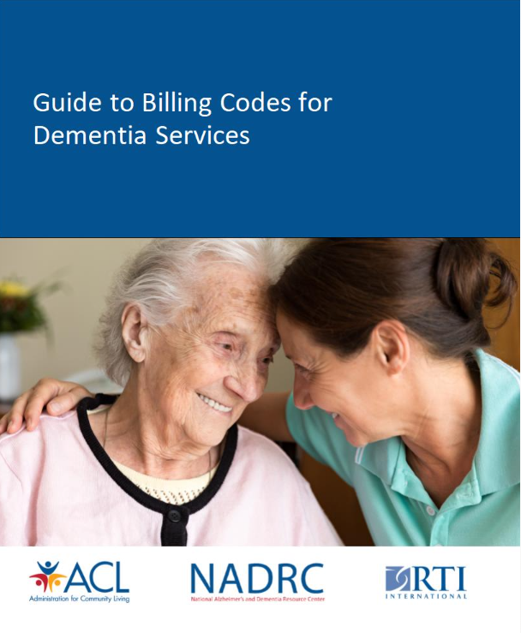
https://view.officeapps.live.com/op/view.aspx?src=https%3A%2F%2Fpblob1storage.blob.core.windows.net%2Fpublic%2Fnadrc%2Fdocs%2FGuide%2520for%2520Billing%2520Codes%2520for%2520Dementia%2520Services%2520Final%2520READ%2520Only.docx&wdOrigin=BROWSELINK
Billing for Dementia and Cognitive Assessment

Slide 28

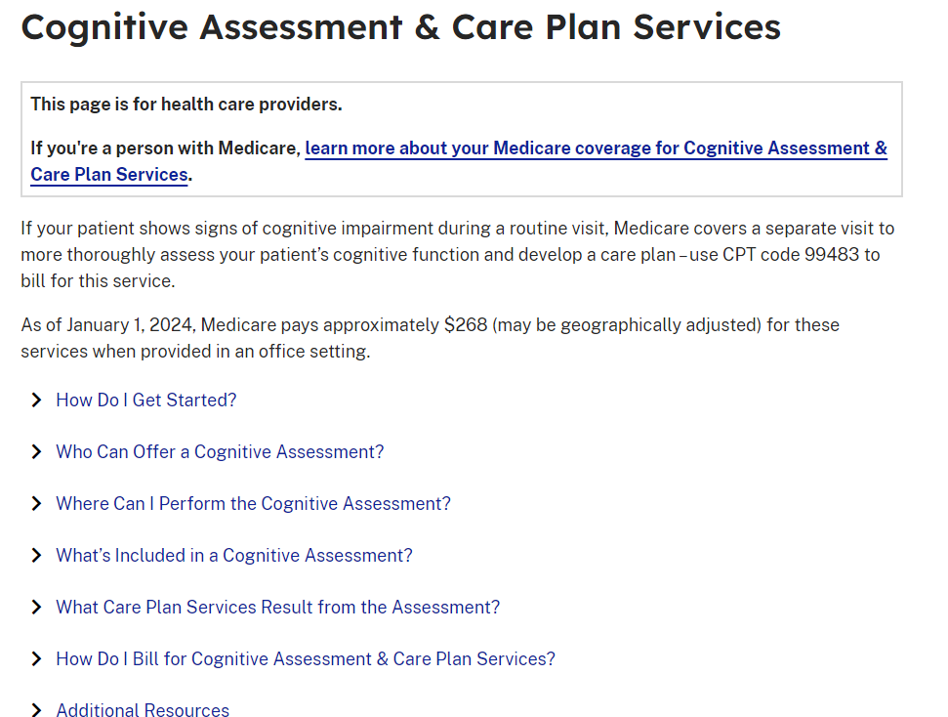

Medicare Services for Cognitive Assessment
https://www.cms.gov/medicare/payment/fee-schedules/physician/cognitive-assessment
Medicare Coverage and Payment of Cognitive Assessment & Care Plan Services (Medicare Learning Network):
https://www.youtube.com/watch?v=ugO2p2EvQQw

Slide 29

Medicare Services for Cognitive Assessment (CMS 2024)
Who can perform:
Any clinician eligible to report evaluation and management (E/M) services can offer this service. Eligible providers include:
Physicians (MD and DO)
Nurse practitioners
Clinical nurse specialists
Physician assistants
What must the clinician do to meet the required elements for code 99483? CPT Code 99483
• Cognition-focused evaluation including a pertinent history and examination;
• Medical decision making of moderate or high complexity;
• Functional assessment (ADL/IADL) including decision-making capacity;
• Use of standardized instruments for staging of dementia (eg, functional assessment staging test [FAST], clinical dementia rating [CDR]);
• Medication reconciliation and review for high-risk medications;
• Evaluation for neuropsychiatric and behavioral symptoms, including depression, including use of standardized screening instrument(s)

Slide 30

Work RVU's for Cognitive assessment
CPT code 99214 Return moderate complexity RVU 1.92
CPT code G0439 Medicare wellness subsequent RVU 1.50
CPT code 99483 Cognitive assessment RVU 3.80 **Can be billed WITH a Medicare Wellness Visit when using 25 modifier**

Slide 31
Resources for Discussion and Assessment of Brain Health

Slide 32
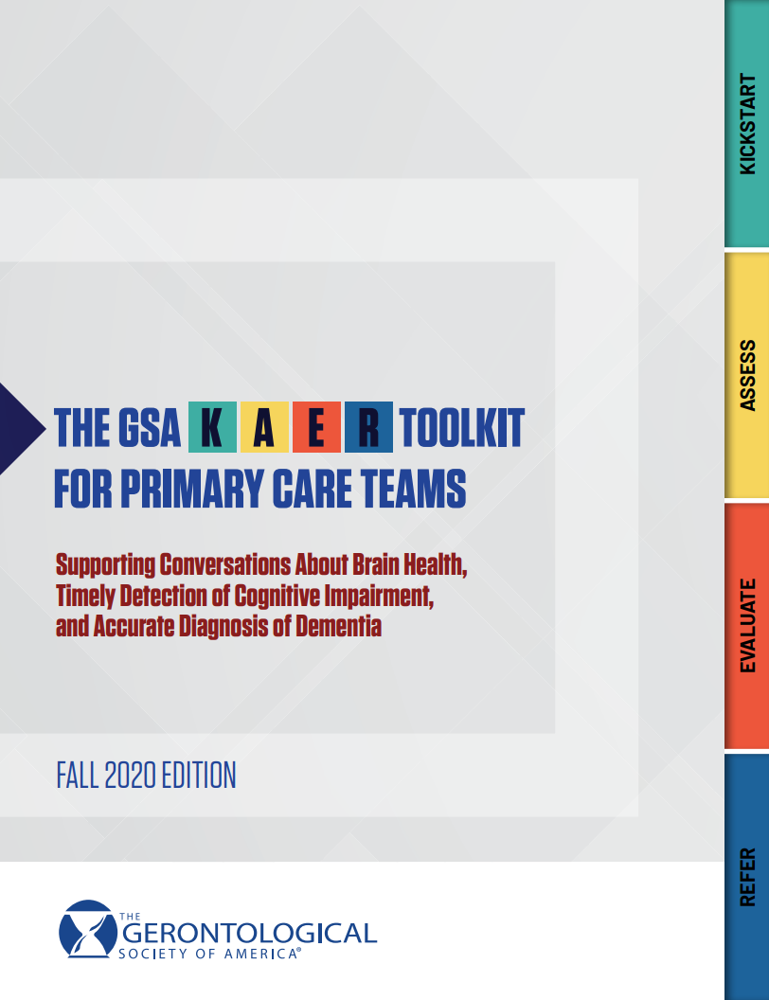
Gerontological Society of America –
KAER
FREE provider resource
GSA KAER Toolkit for Brain Health
  PCPs can use KAER framework to increase brain health conversations, promote early diagnosis of dementia, and improve outcomes

Slide 33
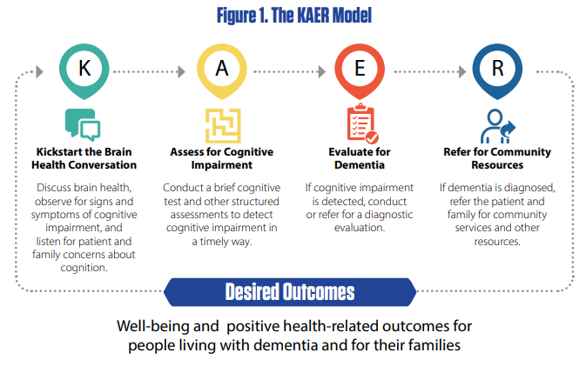
What is GSA KAER toolkit?
Communication
Health & Well-being
Kickstart the Brain Health Conversation
Assess for Cognitive Impairment
Evaluate for Dementia
Refer for Community Resources
Gerontological Society of America. (2020). The GSA KAER toolkit for primary care teams: Supporting conversations about brain health, timely detection of cognitive impairment, and accurate diagnosis of dementia. https://gsaenrich.geron.org/brain-health

Slide 34
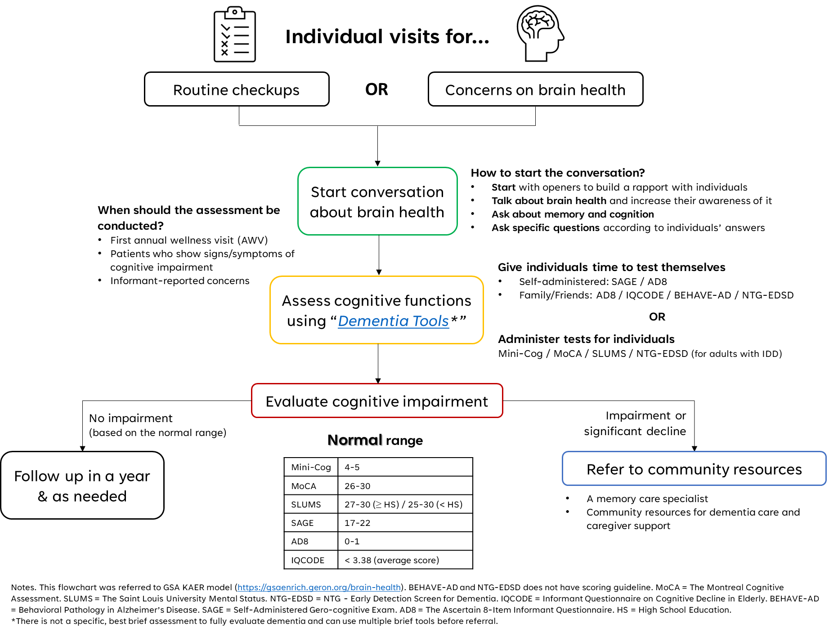

Decision Flowchart
Self- Administered SAGE
AD8 Alzheimers Assoc LA

Slide 35

K=Kickstart

Slide 36
Kickstart the Brain Health Conversation
Raise the topic of brain health and continue the conversation over subsequent visits
Key Messages to Include
  The brain ages, just like other parts of the body.
  Normative cognitive aging is not a disease. Cognitive impairment is not normative aging.
  Cognitive aging is different for every individual.
(Source: GSA KAER Toolkit for Primary Care Teams, Adapted from the Institute of Medicine, 2015)

Slide 37

A=Assess

Slide 38
Assess for Cognitive Impairment
  Use a validated, brief cognitive screening instrument
  Use "Alzheimer's and Related Dementias Interactive Screening and Assessment Tools" as a reference guide
  Training is vital
Name of Test | Distinguishing Features | Number of Items | Time to Administer* | Available in Languages Other Than English
Mini-Cog | • Good sensitivity • Easy to administer and interpret • Does not adjust for education level | Not applicable; 3-word recall and clock-drawing test | 3-5 minutes | Mini-Cog In Other Languages
Clock Drawing Test | Can be rapidly administered to identify structural impairment | Not applicable | Not applicable
The Montreal Cognitive Assessment (MoCA) | • Good sensitivity • Adjusts for education level • Assesses for executive function | 12 | 10 minutes | MoCA questionnaire in French
The Saint Louis University Mental Status (SLUMS) Exam | • Good sensitivity • Adjusts for education level • Assesses for executive function | 11 | 7 minutes | Multi-Language Mental Status Exam
A Short Test of Mental Status (STMS) questionnaire | • Good sensitivity and specificity • Does not adjust for education level • Assesses for executive function | 8 | 5 minutes
*Timing is approximate and will depend on the patients functional status.

Slide 39
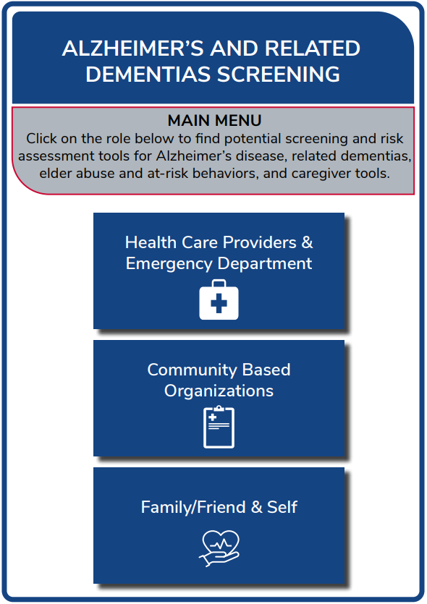
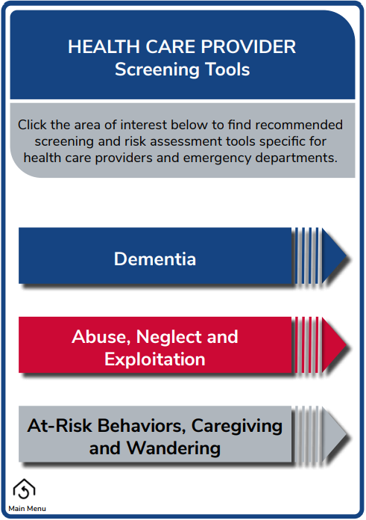
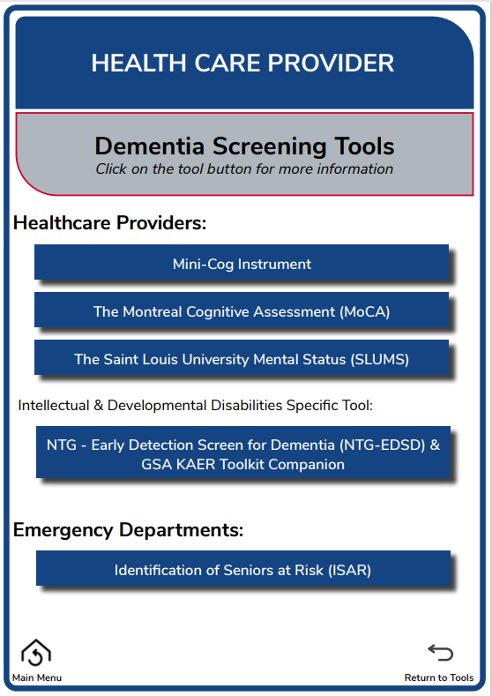
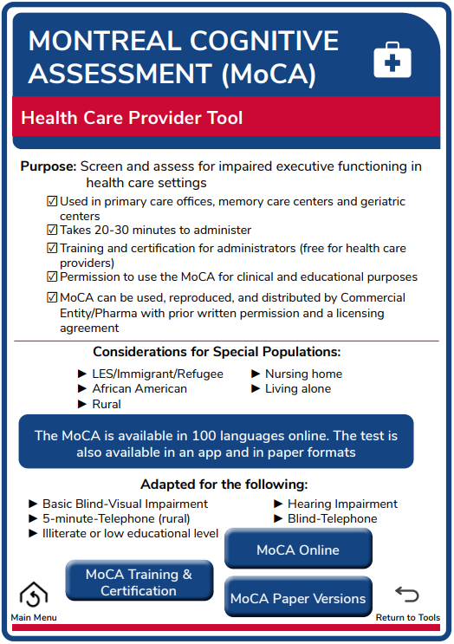

Screening and Assessment Tools
View this interactive screening and assessment tool at https://nursing.osu.edu/sites/default/files/2024-10/ScreeningTools_1.pdf

Slide 40
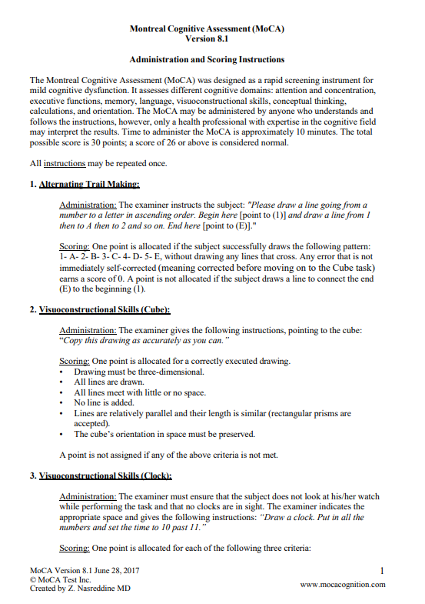
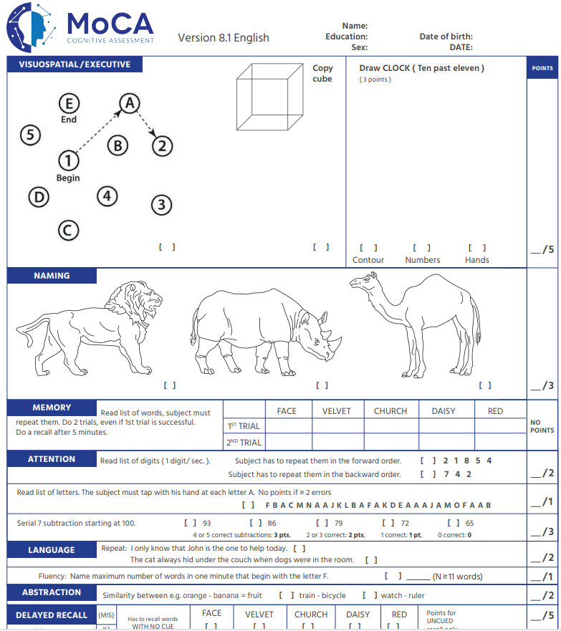
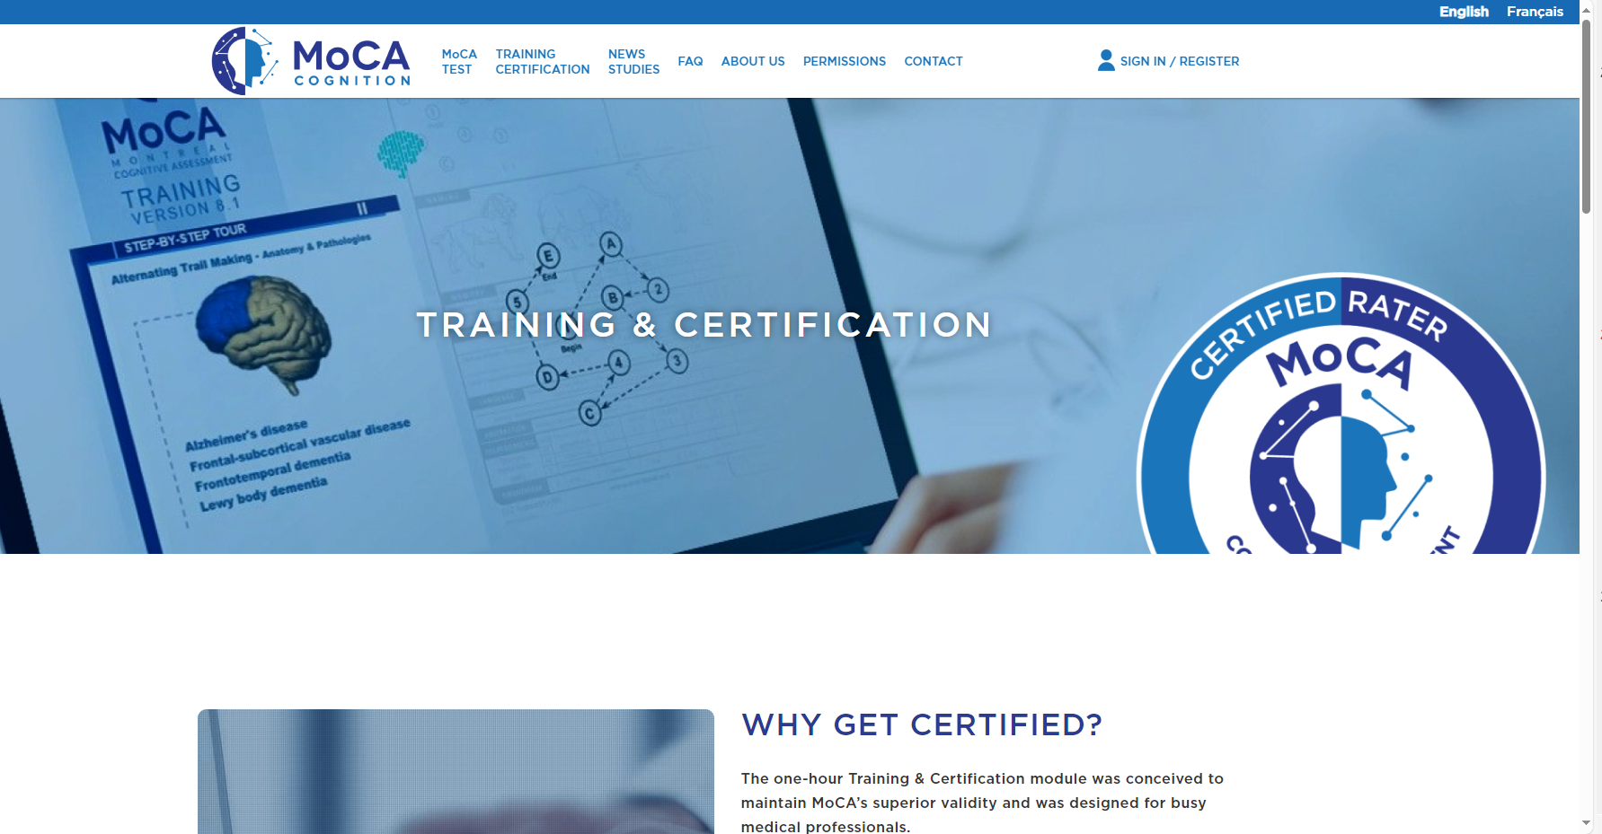
Screening and Assessment Tools
View this interactive screening and assessment tool at https://nursing.osu.edu/sites/default/files/2024-10/ScreeningTools_1.pdf

Slide 41
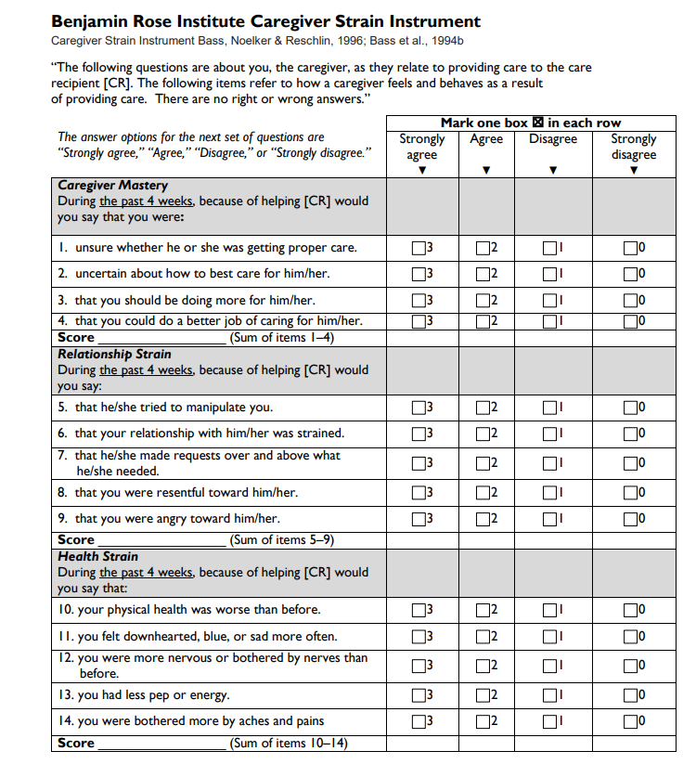
Screening for Caregiver Strain
Use a validated, brief questionnaire to obtain perceptions of carers
Carers are the silent dyad.
  Overwhelmed/depressed (Reuben et al., 2022)
  QOL (Koyama et al., 2017)
  Strain/Burden/Health
Reuben DB, Romero T, Evertson LC, Jennings LA. Overwhelmed: a Dementia Caregiver Vital Sign. J Gen Intern Med. 2022 Aug;37(10):2469-2474. doi: 10.1007/s11606-021-07054-3. Epub 2021 Aug 13. PMID: 34389938; PMCID: PMC9360256.
Koyama A, Matsushita M, Hashimoto M, Fujise N, Ishikawa T, Tanaka H, Hatada Y, Miyagawa Y, Hotta M, Ikeda M. Mental health among younger and older caregivers of dementia patients. Psychogeriatrics. 2017 Mar;17(2):108-114. doi: 10.1111/psyg.12200. Epub 2016 Mar 10. PMID: 26968528.

Slide 42
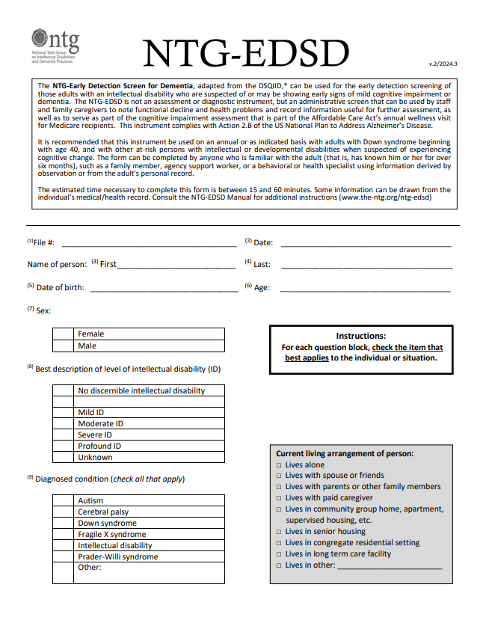
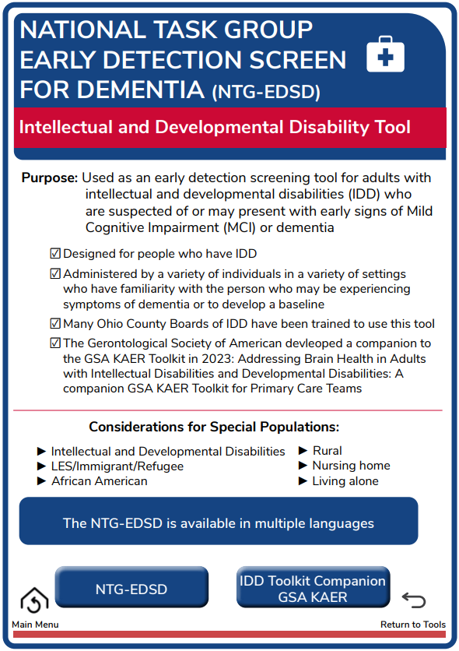
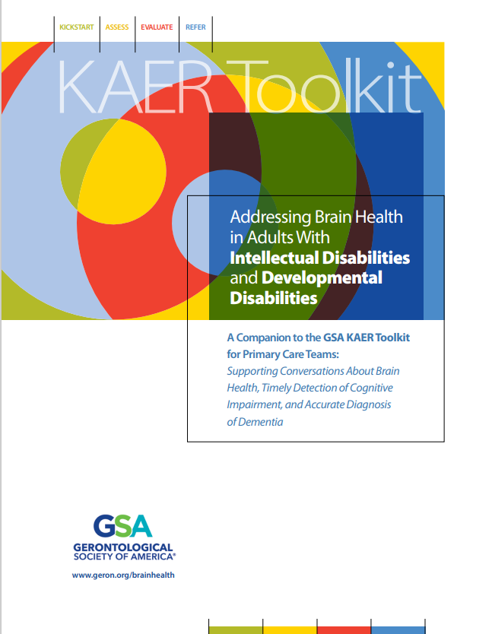
Dementia Care in Adults with IDD
Addressing Brain Health in Adults With Intellectual Disabilities and Developmental Disabilities
IDD companion to the GSA KAER Toolkit
Designed to address the needs of adults with intellectual and developmental disabilities (IDD) who develop dementia
geron.org/brainhealth
National Task Group Early Detection Screen for Dementia (NTG-EDSD)
Dementia screening tool for adults with IDD
https://www.the-ntg.org/ntg-edsd

Slide 43

E=Evaluate

Slide 44
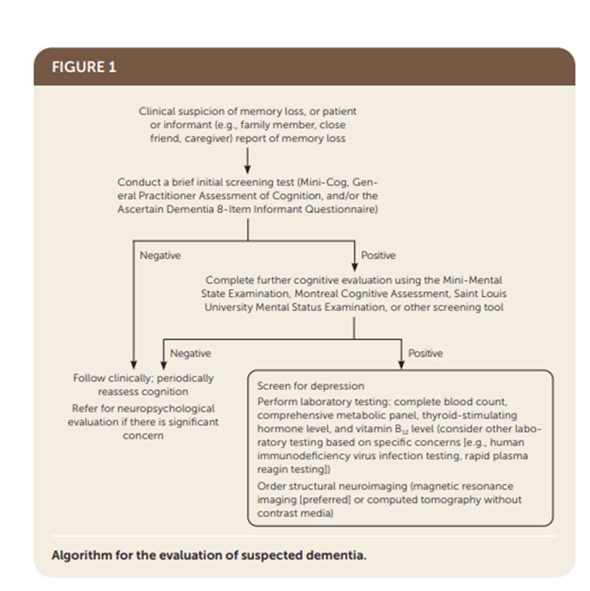
Evaluate Cognitive Impairment
History/physical exam
  Gait, speech, balance, vision, hearing tremor, focal weakness, CVA, ADL, IADL, depression, anxiety
Routine labs
  CBC
  Serum B12
  Serum calcium
  Folate
  Glucose
  TSH, free T4
  Liver function tests
  Renal function tests
Non-contrast CT or MRI (based on H/P potential lesion)
Falk, N., Cole, A., & Meredith, T.J. (2018). Evaluation of Suspected Dementia, 97(6), American Family Physician, 398-405.

Slide 45
Evaluate Cognitive Impairment
Causes of Dementia
  AD, vascular conditions, Lewy body diseases, frontotemporal degeneration, and combinations of these and other conditions
  https://alz.org/media/documents/inbrief-differentiating-dementias.pdf
  https://gamemorynet.org/resource_category/understanding-the-diagnosis/
Resources for Dementia Caused by Alzheimer’s Disease
  https://gamemorynet.org/resource_category/understanding-the-diagnosis/
Resources for Dementia Caused by Vascular Conditions
  https://memory.ucsf.edu/sites/memory.ucsf.edu/files/wysiwyg/UCSF_VaD_Providers_7-13-17.pdf
  https://www.alz.org/professionals/health-systems-clinicians/dementia-diagnosis/differential-diagnosis/differential-diagnosis-of-vascular-dementia
Resources for Dementia Caused by Lewy Body Disease
  https://www.ncbi.nlm.nih.gov/pmc/articles/PMC5496518/
  https://www.ncbi.nlm.nih.gov/pmc/articles/PMC4576496/
  https://www.lbda.org/comprehensive-lbd-symptoms-checklist/
Resources for Dementia Caused by Frontotemporal Degeneration
  https://www.theaftd.org/
  https://www.theaftd.org/for-health-professionals/diagnosing-ftd/
  https://www.theaftd.org/living-with-ftd/resources/

Slide 46
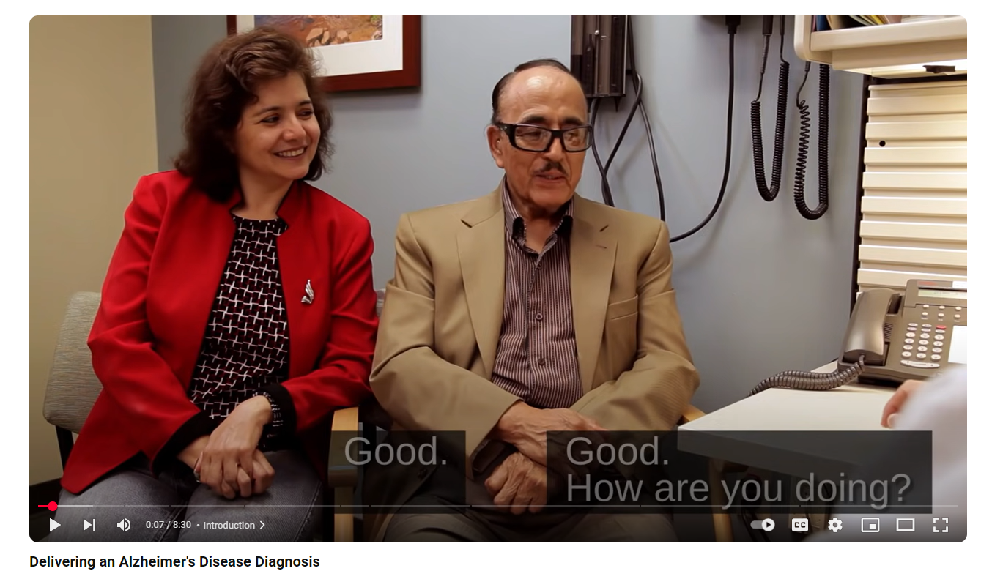
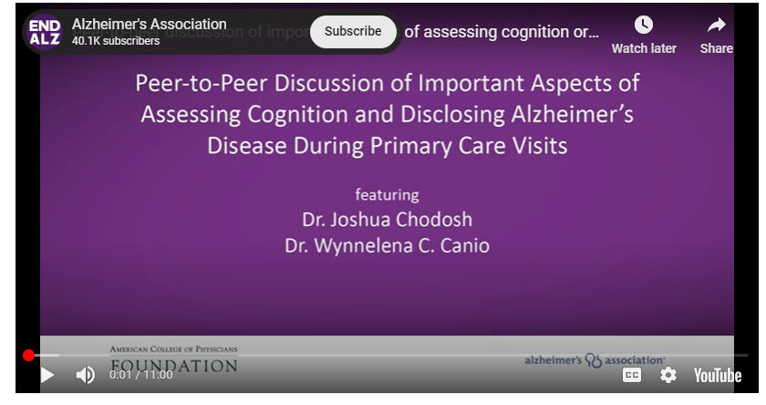
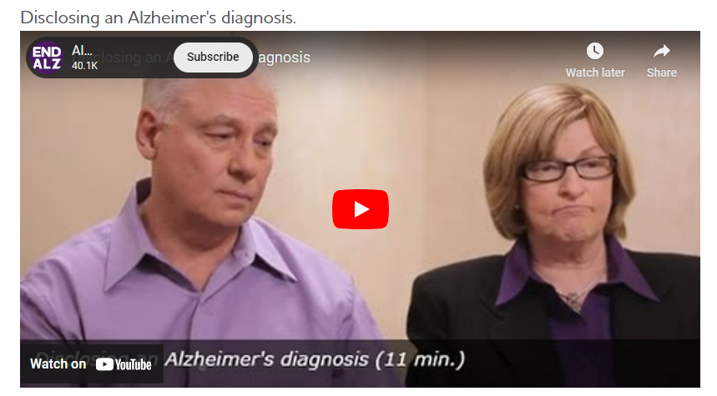
Evaluate Cognitive Impairment
Resources on How to Disclose a Diagnosis of Dementia
Topic | Title | Format
KAER Toolkit | Disclose the Diagnosis | Web-based toolkit
Newly Diagnosed Patient – Setting a Plan | 4-Plan-for-Newly-Diagnosed-Patients.pdf | 1-page summary document
Video featuring a person-centered approach to disclosing a diagnosis | Delivering an Alzheimer's Disease Diagnosis | 8-minute video
Video demonstrating best practices for making disclosure | Disclosing an Alzheimer's Diagnosis | 10-minute video
Sample talking points to use with patients | Group Health Cooperative (2012) Dementia and Cognitive Impairment Diagnosis and Treatment Guide | 1-page summary document
Elements of making disclosure in a person-centered way as a process rather than a single event | Disclosing a Diagnosis of Dementia: Recommendations for a Person-Centered Approach | 5-page peer-reviewed article

Slide 47

R=Refer

Slide 48
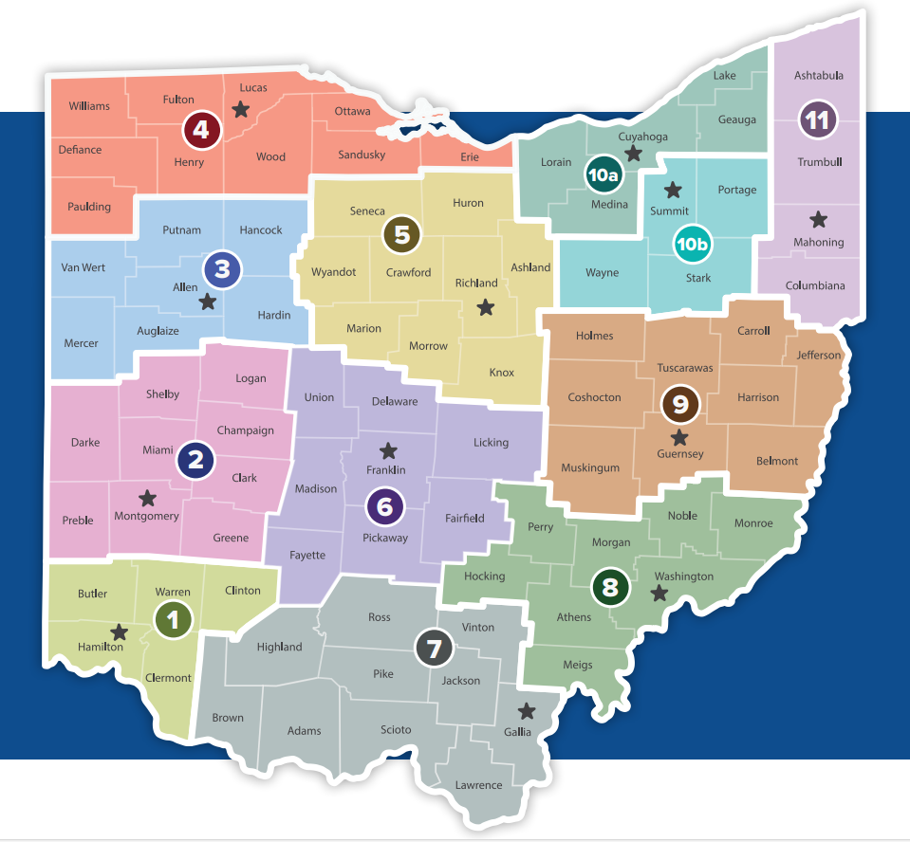
Refer to Community Resources
Find Your Area Agency on Aging
When necessary or available, refer to a specialist
Community support resources
  Golden Buckeye Center for Dementia Caregiving
  Ohio Area Agencies on Aging
  Alzheimer’s Association
  Best Programs for Caregiving
  211
  AARP

Slide 49
Referral Protocol & Toolkit
What are you looking for?
Get Connected!
Click the red links below to view Ohio programs and services
A Medical Assessment to Determine or Confirm Whether Somone has Dementia
Examples: Comprehensive medical exam; Dementia diagnostic assessment; Neuropsychological testing
Care Planning and Managing Care for Memory Loss, Dementia, and Caregiving
Examples: Find solutions to concerns or problems; Personalized care planning; Find and coordinate medical and non-medical services; Emotional support
Basic Information on Memory Loss or Dementia
Examples: Recognizing symptoms and warning signs; Treatment options; Normal aging vs. dementia; Assistance for persons living with memory loss or dementia and support for family and friend caregivers
Dementia Diagnostic Centers
Golden Buckeye Center for Dementia Caregiving
Alzheimer’s Association
Other Helpful Resources
Area Agency on Aging
Best Programs for Caregiving
https://nursing.osu.edu/offices-and-initiatives/golden-buckeye-center-dementia-caregiving/referral-protocol

Slide 50
Referral Protocol & Toolkit
What are you looking for?
Get Connected!
Click the red links below to view Ohio programs and services
Strategies for Coping with Caregiving, Care Tasks, and Competing Responsibilities
Examples: Performing caregiving tasks; Managing symptoms; Effective communication techniques; Effective coping; Personal care & daily activities; Emotional support
Programs and Services for Memory Problems, Dementia, or Other Health Problems
Examples: Healthcare & community services; Support for caregivers; Help with daily activities, personal care, transportation, case management; Care facilities
Breaks from Caregiving
Examples: Places where people with dementia can stay to receive care for all or part of the day; Staff who come to the home to provide care; Facilities where people with dementia can stay overnight
Alzheimer’s Association
Area Agency on Aging
Best Programs for Caregiving
Other Helpful Resources
Memory Café Directory
Best Programs for Caregiving
Dial 2-1-1
Area Agencies on Aging
AARP
Adult Day Programs
Respite Programs
https://nursing.osu.edu/offices-and-initiatives/golden-buckeye-center-dementia-caregiving/referral-protocol

Slide 51
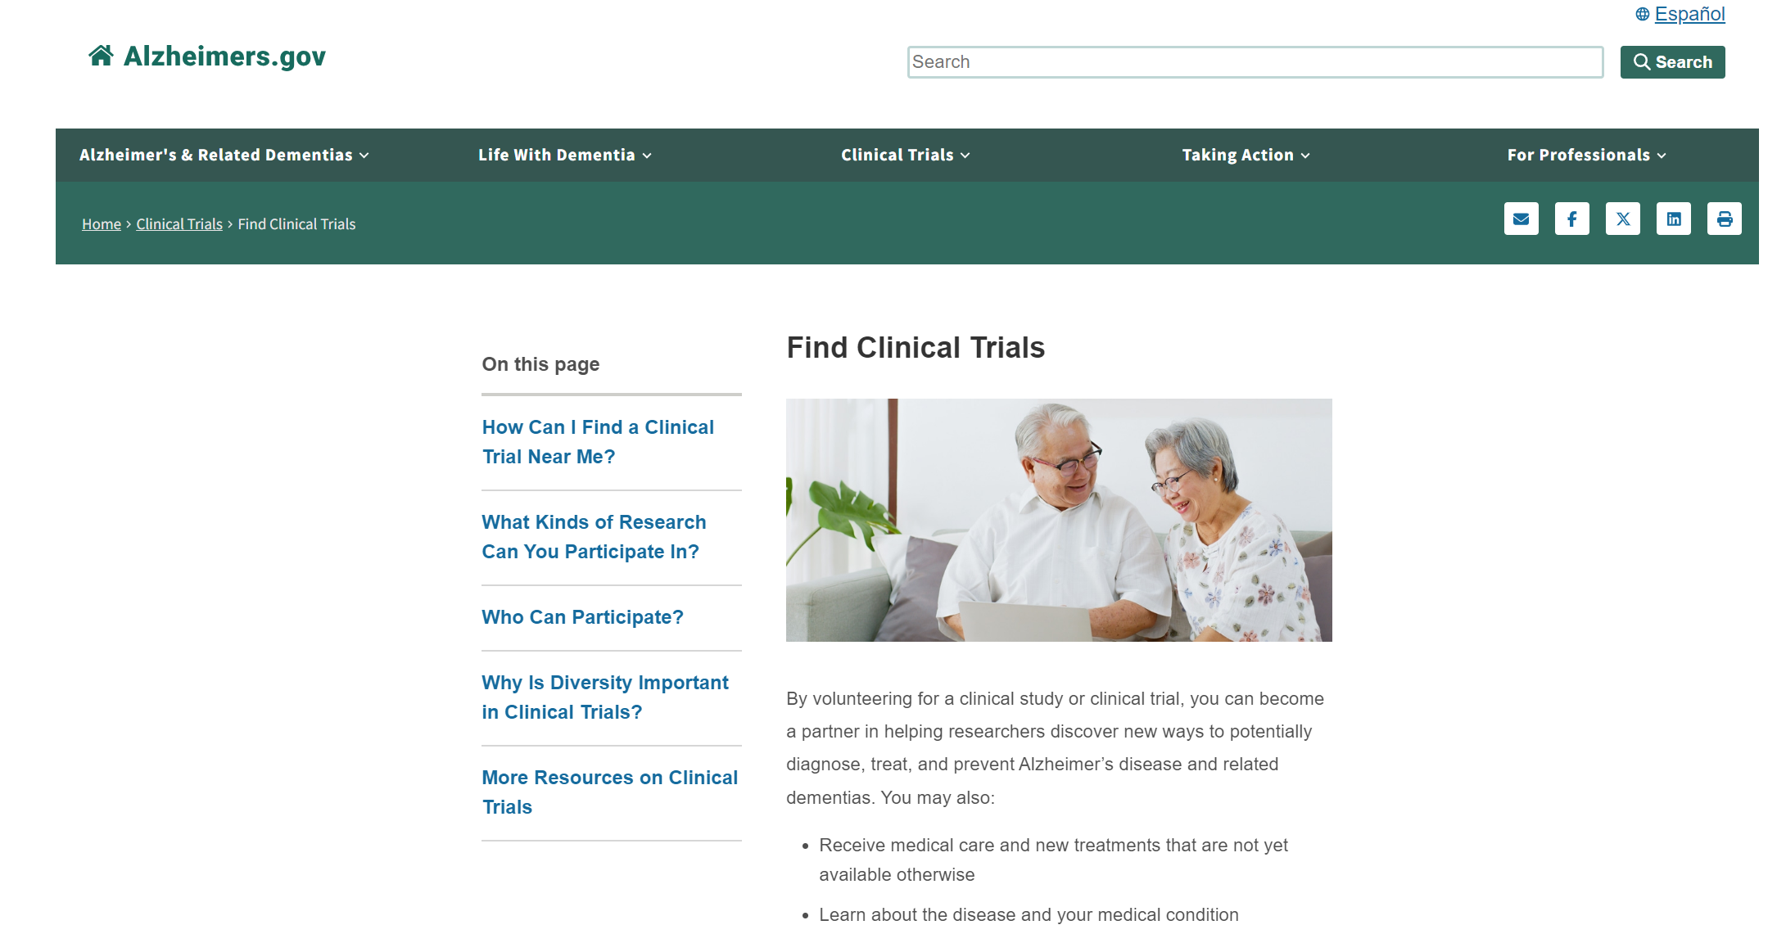
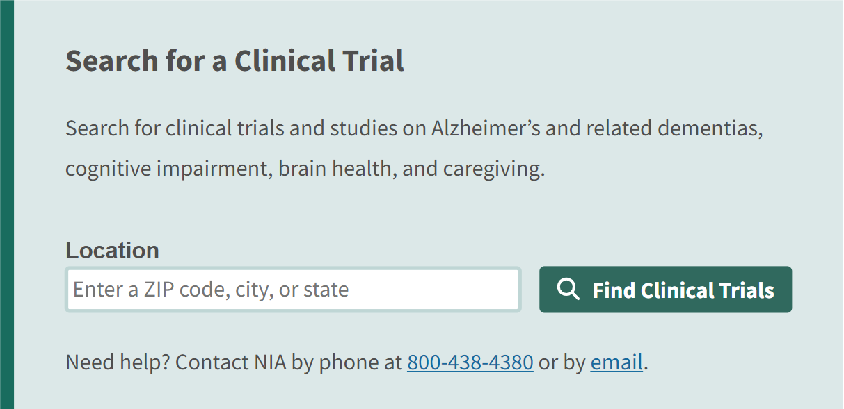
Clinical Trials
https://www.alzheimers.gov/clinical-trials/find-clinical-trials

Slide 52
Key Takeaways
PCPs are situated to recognize and diagnose MCI and dementia
HP 2030 aims to increase early detection of dementia
Pharmacological and nonpharmacological management strategies are available
GSA KAER is an excellent resource for dementia detection, dx evaluation, treatment, and referral
Valid and reliable screening tools exist for dementia
Brain health conversations are essential to care management and should be normalized
Refer to a specialist if possible
Current research on monoclonal antibodies shows promise

Slide 53

Please Complete our Evaluation
https://bit.ly/Clinician-Session-Eval

Slide 54

Discussion & Questions
Please complete our evaluation form: https://bit.ly/Clinician-Session-Eval

Slide 55


Resources
Website:
https://nursing.osu.edu/dementiacaregiving
Contact number:
1-800-645-2946
Location:
760 Kinnear Road, Columbus, Ohio 43212
Website:
https://aging.ohio.gov/
https://aging.ohio.gov/find-services
Contact number:
1-800-266-4346 (general)
1-866-243-5678 (finding local services)

Slide 56
References
2024 Alzheimer's disease facts and figures. Alzheimers Dement. 2024 May;20(5):3708-3821. doi: 10.1002/alz.13809. Epub 2024 Apr 30. PMID: 38689398; PMCID: PMC11095490.
Act on Alzheimer’s. (2016). Clinical Provider Practice Tool. In Act on Alzheimer’s. Retrieved March 18, 2024, from https://actonalz.org/sites/default/files/2022-04/ACTNAT-Provider-ClinicalPracticeTool.pdf
Alzheimer’s Association. (2023). 2023 Alzheimer’s disease facts and figures. Alzheimer’s & Dementia, 19(4), 1598–1695. https://doi.org/10.1002/alz.13016
Cognitive Assessment & Care Plan Services | Guidance Portal. (2021). https://www.hhs.gov/guidance/document/cognitive-assessment-care-plan-services-0
Cordell, C. B., Borson, S., Boustani, M., Chodosh, J., Reuben, D., Verghese, J., Thies, W., Fried, L.B., & Medicare Detection of Cognitive Impairment Workgroup. (2013). Alzheimer's Association recommendations for operationalizing the detection of cognitive impairment during the Medicare Annual Wellness Visit in a primary care setting. Alzheimer's & Dementia, 9(2), 141-150. http://dx.doi.org/10.1016/j.jalz.2012.09.011
Chronic Disease Stats & Facts for Ohio: Cognitive Decline & Dementia. Oct 2020. https://odh.ohio.gov/wps/wcm/connect/gov/44a0bd5b-045a-488c-9730-e72fd38207fd/Cognitive+Decline+and++Dementia+in+Ohio+Fact+Sheet_Final.pdf?MOD=AJPERES&CONVERT_TO=url&CACHEID=ROOTWORKSPACE.Z18_K9I401S01H7F40QBNJU3SO1F56-44a0bd5b-045a-488c-9730-e72fd38207fd-npD1eEi
Di Lorito C, Long A, Byrne A, Harwood RH, Gladman JRF, Schneider S, Logan P, Bosco A, van der Wardt V. Exercise interventions for older adults: A systematic review of meta-analyses. J Sport Health Sci. 2021 Jan;10(1):29-47. doi: 10.1016/j.jshs.2020.06.003. Epub 2020 Jun 7. PMID: 32525097; PMCID: PMC7858023
Drabo EF, Barthold D, Joyce G, Ferido P, Chang Chui H, Zissimopoulos J. Longitudinal analysis of dementia diagnosis and specialty care among racially diverse Medicare beneficiaries. Alzheimers Dement. 2019 Nov;15(11):1402-1411. doi: 10.1016/j.jalz.2019.07.005. Epub 2019 Sep 4. PMID: 31494079; PMCID: PMC6874742.
Falk, N., Cole, A., & Meredith, T.J. (2018). Evaluation of Suspected Dementia, 97(6), American Family Physician, 398-405.
Gerontological Society of America. (2020). The GSA KAER toolkit for primary care teams: Supporting conversations about brain health, timely detection of cognitive impairment, and accurate diagnosis of dementia. https://gsaenrich.geron.org/brain-health
Koyama A, Matsushita M, Hashimoto M, Fujise N, Ishikawa T, Tanaka H, Hatada Y, Miyagawa Y, Hotta M, Ikeda M. Mental health among younger and older caregivers of dementia patients. Psychogeriatrics. 2017 Mar;17(2):108-114. doi: 10.1111/psyg.12200. Epub 2016 Mar 10. PMID: 26968528.
Liss JL, Seleri Assunção S, Cummings J, et al. Practical recommendations for timely, accurate diagnosis of symptomatic Alzheimer’s disease (MCI and dementia) in primary care: a review and synthesis. J Intern Med. 2021;290(2):310-334. 706.
Older Adults - Healthy People 2030 | health.gov. (n.d.). https://health.gov/healthypeople/objectives-and-data/browse-objectives/older-adults
Ornish D, Madison C, Kivipelto M, Kemp C, McCulloch CE, Galasko D, Artz J, Rentz D, Lin J, Norman K, Ornish A, Tranter S, DeLamarter N, Wingers N, Richling C, Kaddurah-Daouk R, Knight R, McDonald D, Patel L, Verdin E, E Tanzi R, Arnold SE. Effects of intensive lifestyle changes on the progression of mild cognitive impairment or early dementia due to Alzheimer's disease: a randomized, controlled clinical trial. Alzheimers Res Ther. 2024 Jun 7;16(1):122. doi: 10.1186/s13195-024-01482-z. PMID: 38849944; PMCID: PMC11157928.
Reuben DB, Romero T, Evertson LC, Jennings LA. Overwhelmed: a Dementia Caregiver Vital Sign. J Gen Intern Med. 2022 Aug;37(10):2469-2474. doi: 10.1007/s11606-021-07054-3. Epub 2021 Aug 13. PMID: 34389938; PMCID: PMC9360256.
Scharre, D. W., & Trzepacz, P. T. (2013). Evaluation of cognitive impairment in older adults. Focus, 11(4), 482-500.
Vespa, J., Medina, L., & Armstrong, D. M. (2018). Demographic Turning Points for the United States: Population Projections for 2020 to 2060 (pp. 25–1144). US Department of Commerce, Economics and Statistics Administration, US Census Bureau.

