Slide 1

Out of State Electronic Fingerprinting
College of Nursing

Slide 2
Fast Fingerprints
The Ohio Attorney General’s office has engaged in a pilot program with Fast Fingerprints, a national background check company, to submit electronic out of state fingerprints to the AG’s office.
Please visit the website to register for an out of state fingerprint appointment and follow the instructions on the link. A step-by-step guide is provided in the following slides.
Should you have questions, please contact FastFingerprints by visiting this link https://www.fastfingerprints.com/contact/ or call FastFingerprints at 614-457-8900 option 2 for further instructions.

Slide 3
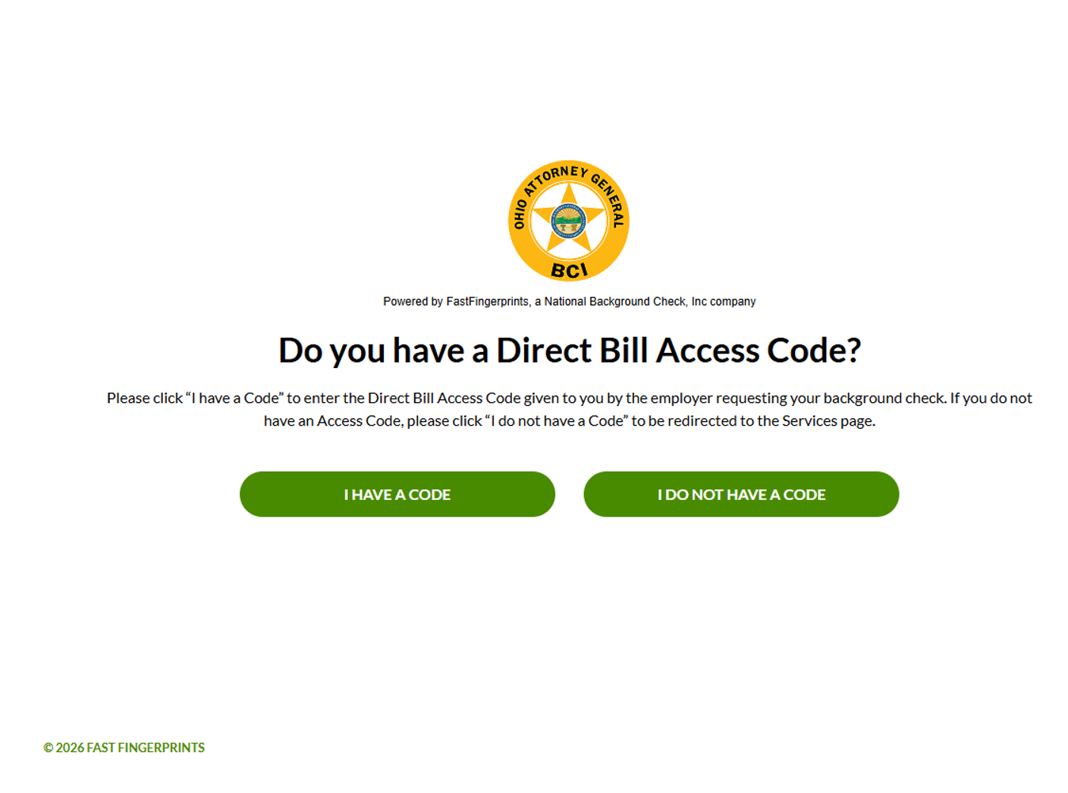
Start the application process…
Begin your application online by simply choosing “I do not have a code”.

Slide 4
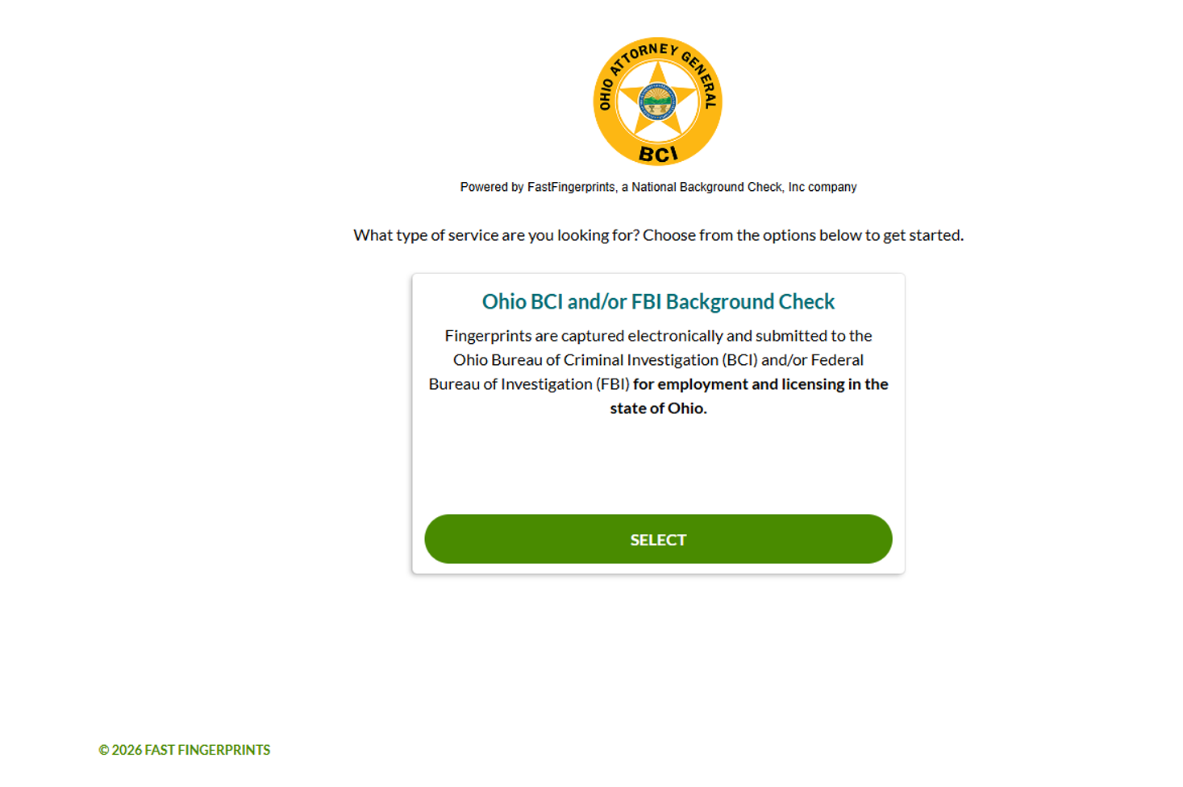
Choose your service…
Select Ohio BCI and/or FBI Background Check

Slide 5
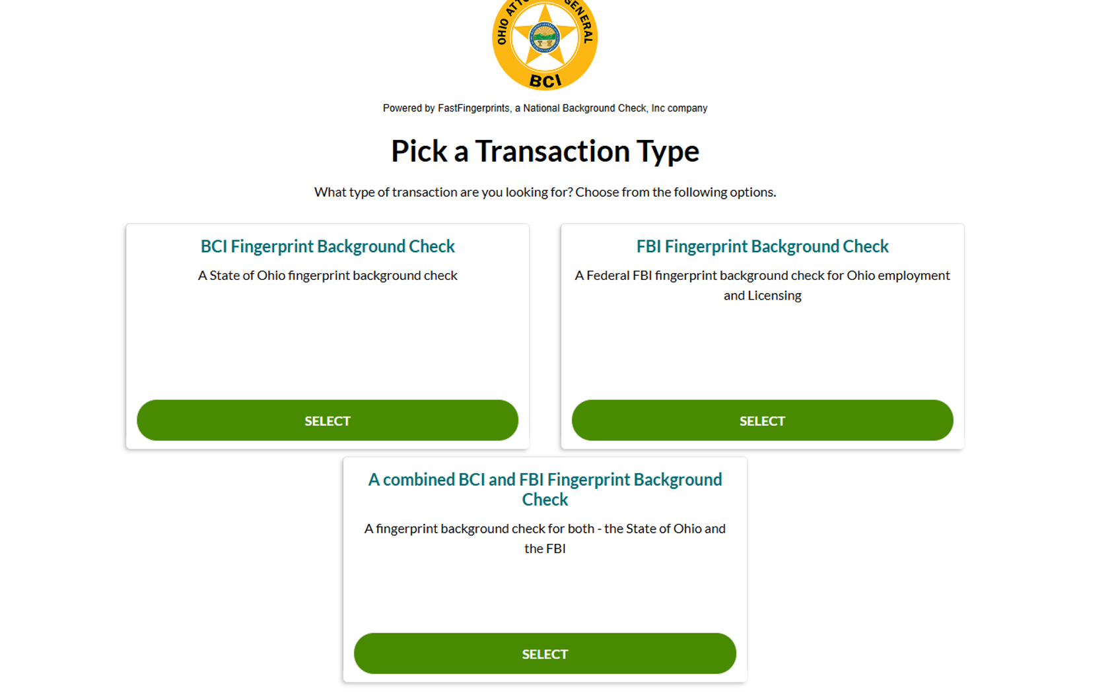
Pick a Transaction Type
Select “A combined BCI and FBI Fingerprint Background Check”

Slide 6
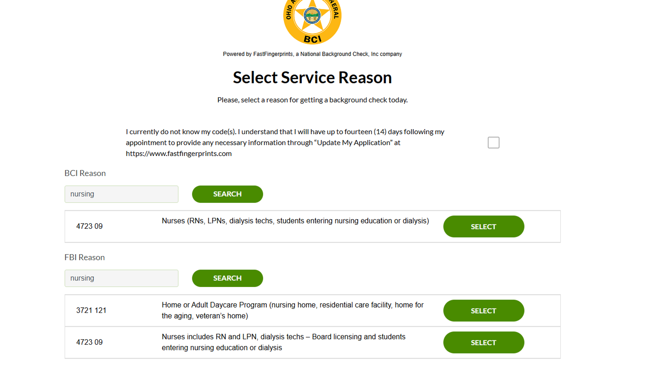
Enter your BCI and FBI ORC Reason Codes
The codes required for Nursing is 4723 09 “Nurses (RNs, LPNs dialysis techs, students entering nursing education or dialysis)”. You can also search for the codes by typing “nursing” in the search bar.

Slide 7
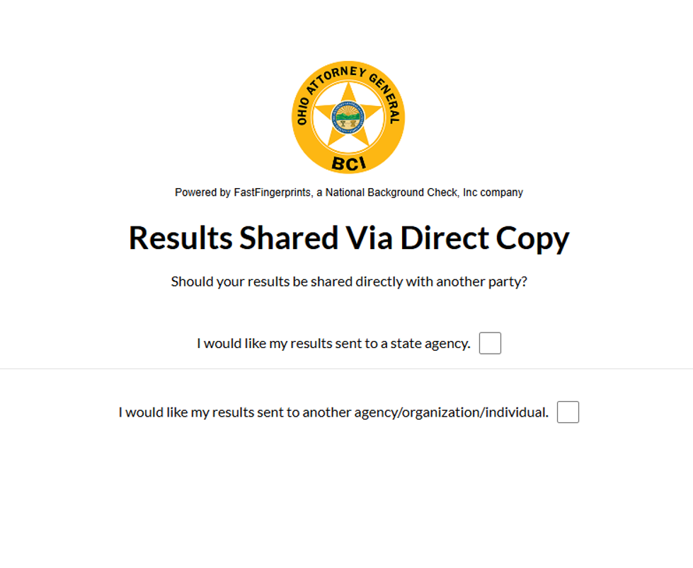
Where/How to Deliver Your Results…
Select “I would like my results sent to another agency/organization/individual.

Slide 8
Where/How to Deliver your Results
If results also need sent to the “Ohio Board of Nursing” select, “I would like my results sent to a state agency and select “Ohio Board of Nursing” from the drop down.

Slide 9
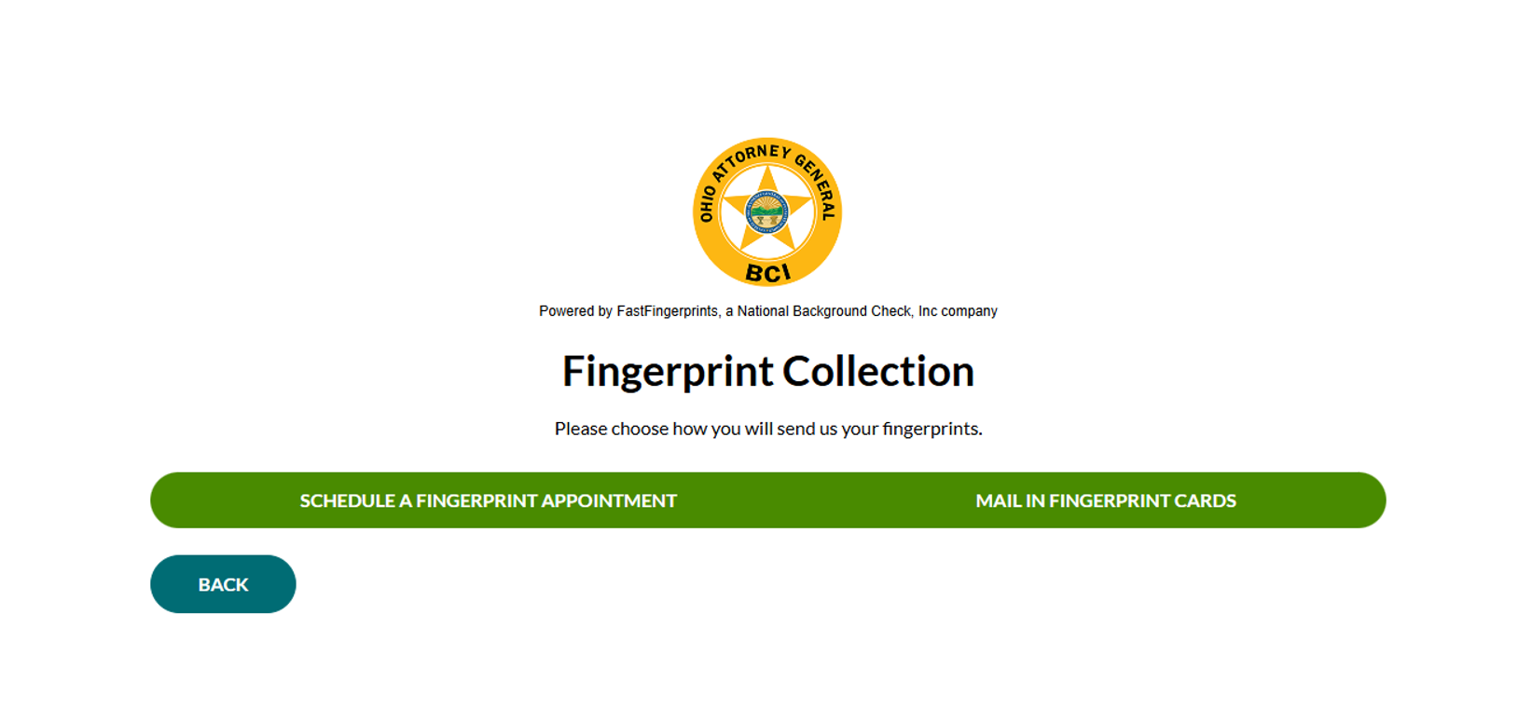
Electronic Prints or Mailed Fingerprint Cards
Please select “Schedule a Fingerprint Appointment”

Slide 10
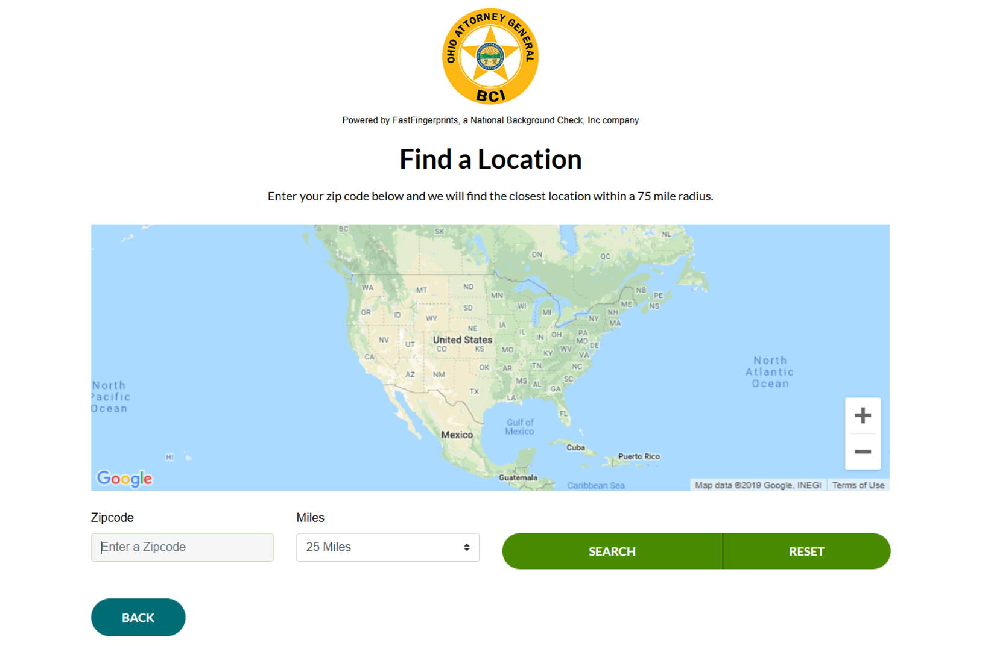
Search for a location near you
Please use the Zip Code search to find an electronic fingerprinting location close to you. If one is not available, you will be prompted to mail fingerprint cards to the address provided following your application.

Slide 11
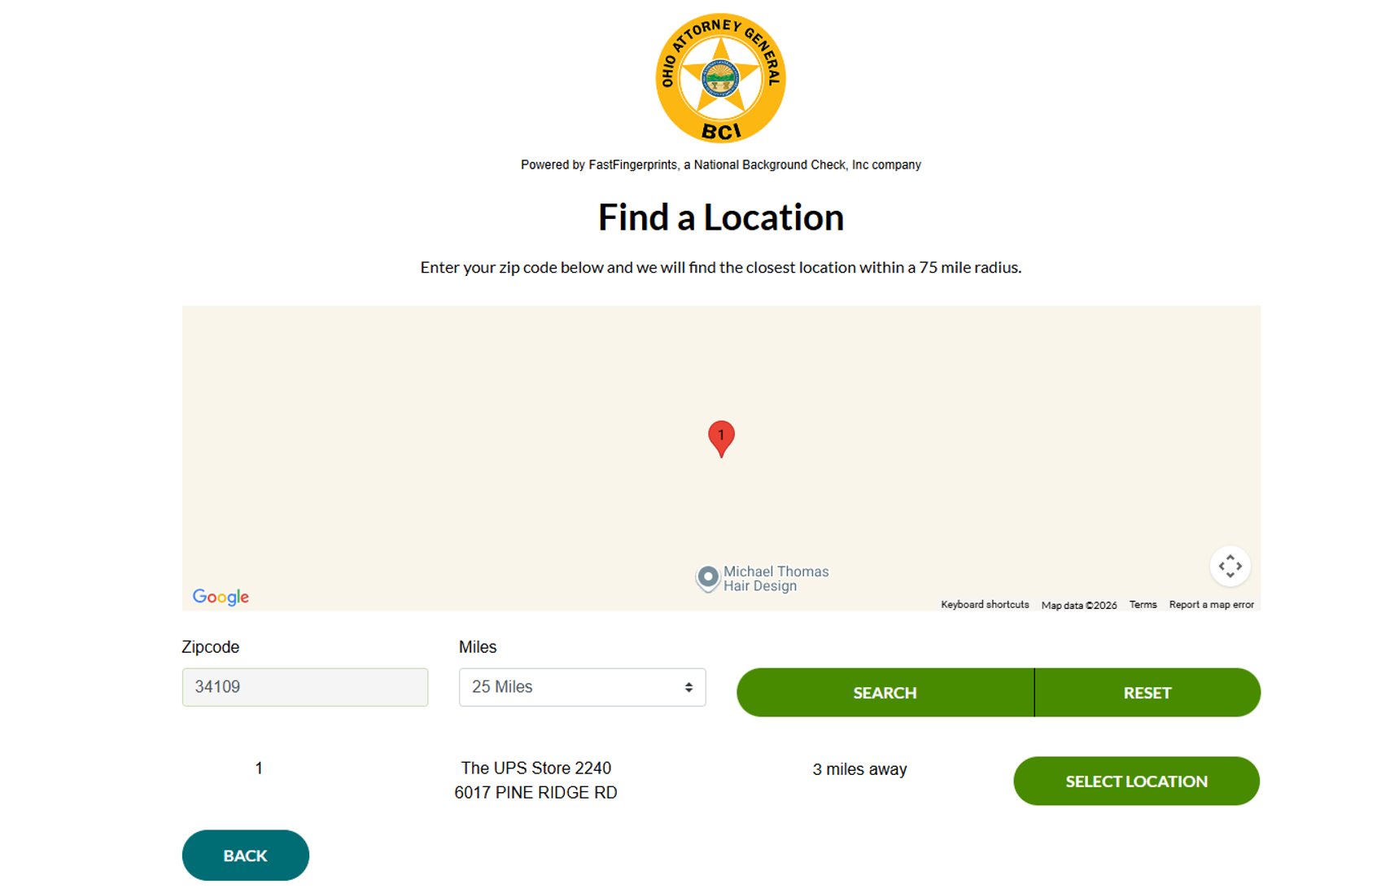
Select Your Location

Slide 12
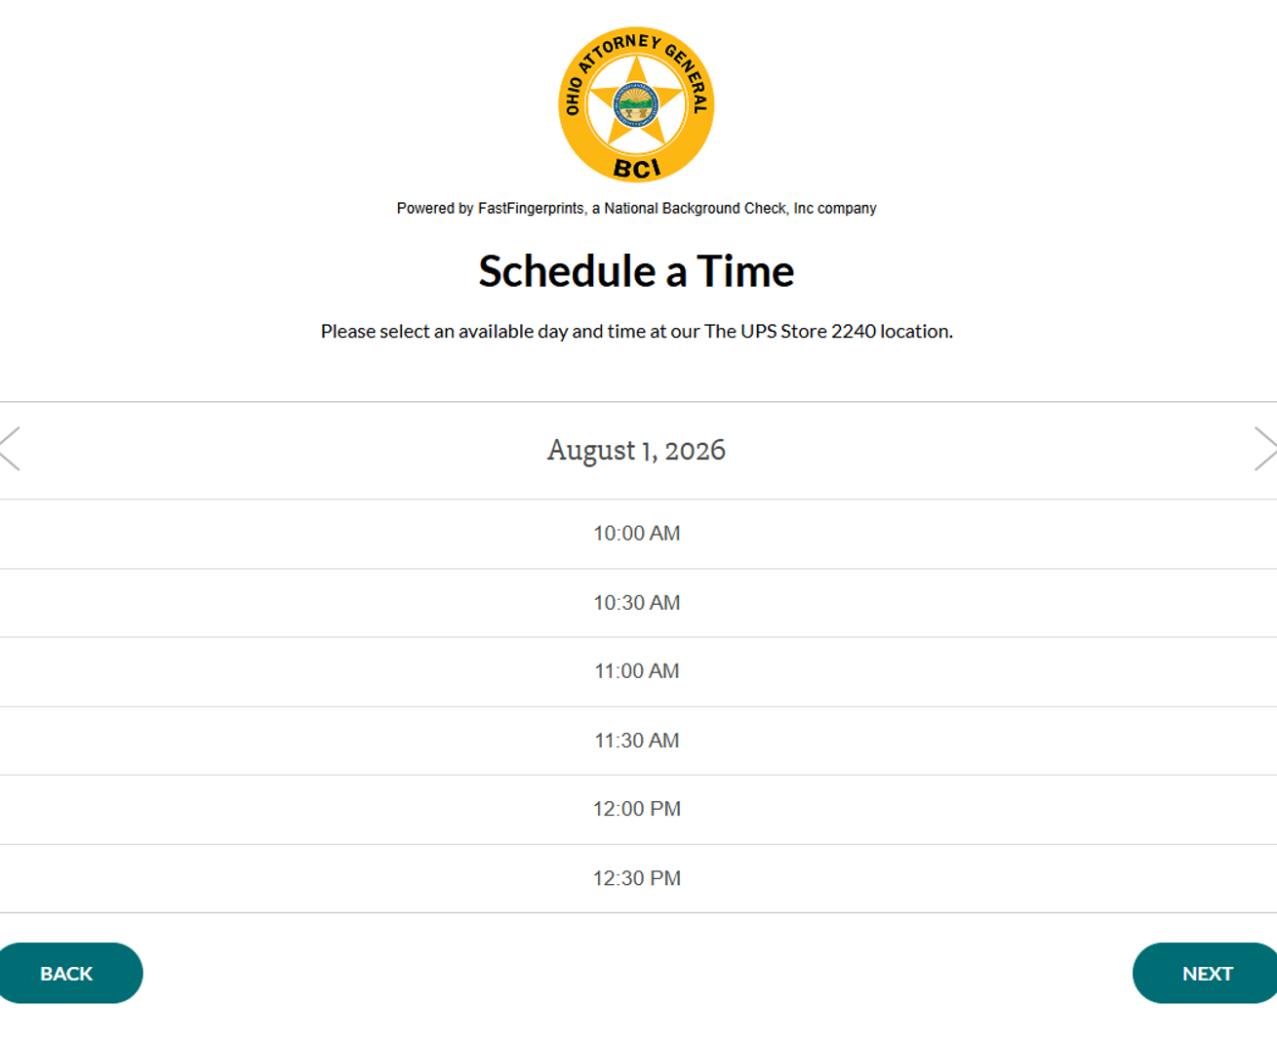
Schedule a Time…
Please choose your preferred date and time. If the initial date displayed does not work for you, simply click the arrow (>) by the date to scroll to additional options. You’ll need to bring a valid photo ID with you to your appointment.

Slide 13
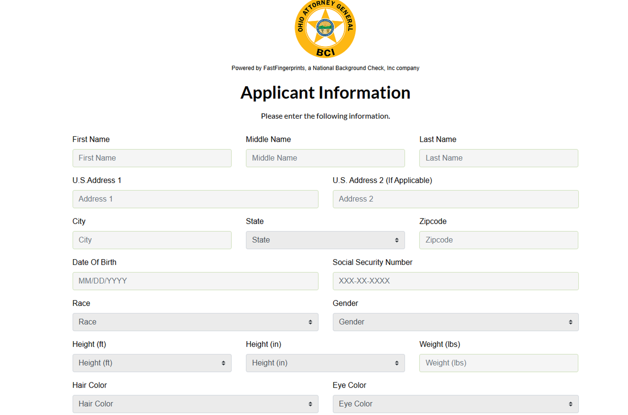
Enter Your Applicant Information…

Slide 14
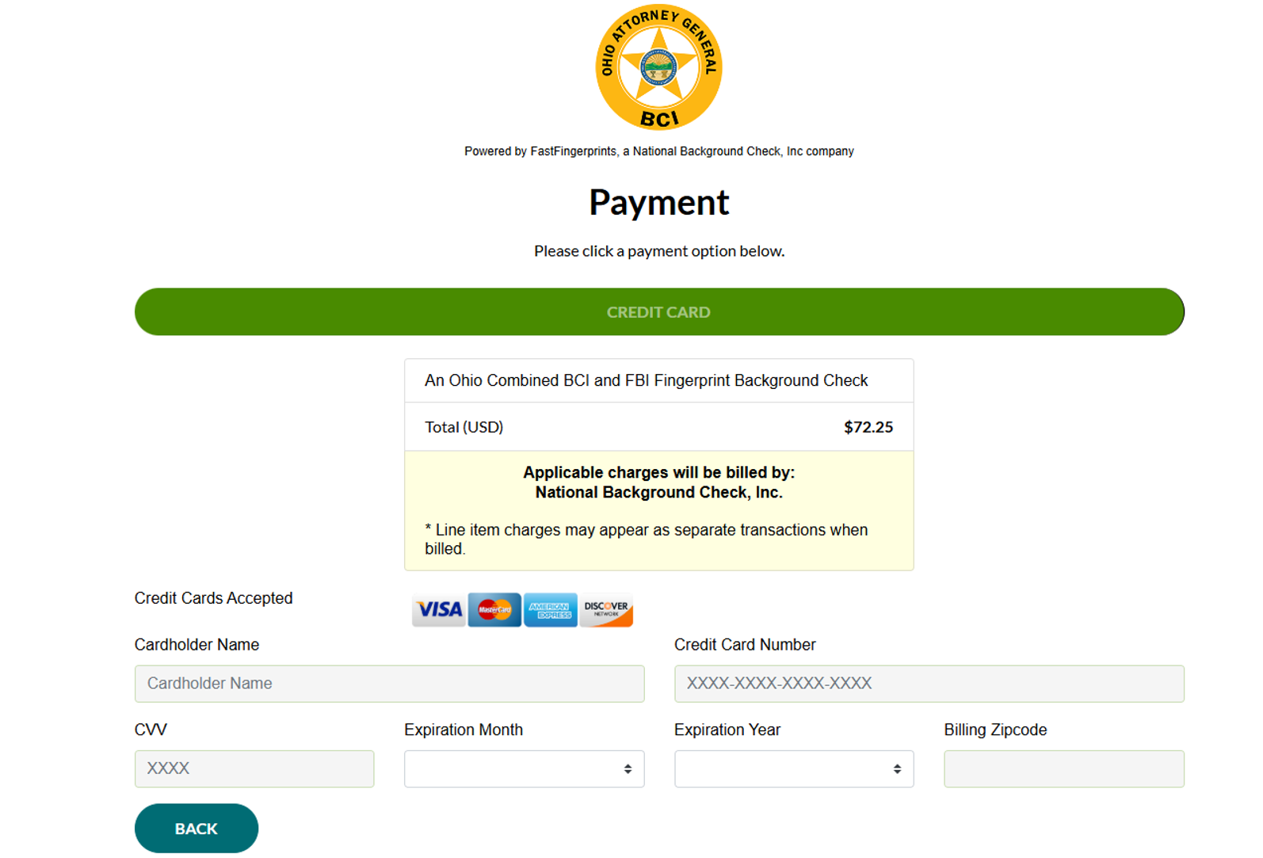
Select a Payment Option

Slide 15
Review and Consent
Once you submit your payment, a screen will appear that allows you to review your Application Summary. Information on this screen includes your personal information, service (BCI/FBI) and reason codes, mail to information and payment. Please make sure your information is accurate.
You will then be asked to provide consent and release. .
NOTE: Please be advised that FastFingerprints, is not responsible for any errors or omissions entered by the applicant. Furthermore, FastFingerprints can make no guarantees of the completeness or accuracy of the information provided by the applicant.

Slide 16
Next Steps
Check your email – A confirmation email with your appointment details including your Appointment ID or QR Code and next steps was sent to the email address you provided in your application. This information plus an acceptable ID will need to be presented to the technician at your appointment.
Capture your fingerprints – Visit the location you selected at your scheduled appointment date and time to get your fingerprints
Provide any additional information – visit www.fastingerprints.com and under the “Customer Resources” tab, please select “Update My Application” to update any necessary information required to obtain your background check results. This may include:
  Transaction Type(s)
  BCI and/or FBI codes
NOTE: this information is required within fourteen (14) days of your fingerprinting appointment. Failure to do so will result in requiring a new transaction and no refunds will be given.

Slide 17
Results
If you selected
Office of Human Resources – Background Checks Nursing
1590 N High St, Suite 300
Columbus, OH 43201
your results will be mailed from the Attorney General’s office to the background check office within 30-45 days of your fingerprint appointment.
Should you have questions about the out of state fingerprinting process, please contact FastFingerprints by visiting this link https://www.fastfingerprints.com/contact/ or call FastFingerprints at 614-457-8900 option 2 for further instructions.

